Slide 1
CNN IMAGE CLASSIFICATION
WITH CIFAR-10
Sylvia Perez Montero & Diego Rosa Paz
1/24/2025

Slide 2
CNN IMAGE CLASSIFICATION
About CIFAR-10
Processing
Training
Transfer Learning and Tuning

Slide 3
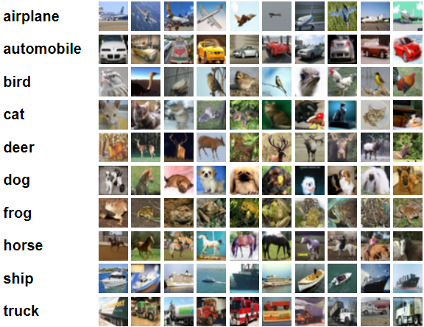
About CIFAR-10
Name
Department Course Number Section Time Location
DATE
A database of 60,000 images of a 32x32 size. 6,000 images fit into each of its classes. 50,000 of these are for training and 10,000 for testing.

Slide 4
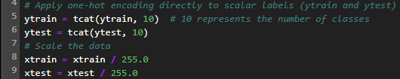
Processing CIFAR-10
Processing
Before introducing the dataset into a model, the ytrain and ytest, they were encoded using to_categorical, while xtrain and xtest were scaled to 1. In addition to this, data augmentation was used to randomize the width and height 10%.
One Hot Encoding

Slide 5

Training the CNN Model
Training
Initially, trying models of our own design didn’t yield accuracy above 10 or 15%. At this point we looked up some CIFAR-10 models.
Using a sequential model from Fares Sayah on kaggle, the difference in the amount of layers and the improved accuracy was apparent quickly.
This was a model of about 20 layers, 6 of these are convolutional layers in sets of 2 with filter values scaling from 32 to 64 to 124. After each of these batch normalization, maxpool2d and dropout are used. Notably in the last 4 consist of flatten, dense, dropout and end with dense with a softmax activation.
This model was able to reach accuracies around 85% after 50 epochs. Our attempts to tune the model or alter parameters didn’t surpass this accuracy as we tended to reduced the epochs.

Slide 6
Transfer Learning and Tuning
Apply the ROC-AUC metric
Fine-tune DenseNet121
Introduce more diversity within the augmentations (zoom, rotation, cutout)
Applying label smoothing to soften the one-hot encoded labels
Upscaling the resolution of the CIFAR-10 images
Notes:
ROC-AUC: Receiver Operating Characteristic - Area Under Curve. Evaluates how well the model distinguishes between classes. Measures the trade-off between the recall and false positive rates across various thresholds.
Fine tuning: unfreezing some layers of the DenseNet121 model and training them on the CIFAR-10 dataset. Lower layers remain frozen to retain pre-trained lower-level features
More diverse data augmentation: the more advanced augmentations simulate real world variations to improve the model’s robustness.
Label smoothing: adjusts the one-hot encoded labels to reduce confidence in predictions. This reduces the model’s tendency to overfit (by making predictions less confident). Also helps regularize the model and improves generalization.
Upscaling: CIFAR-10 images are very small, so deep models like DenseNet121 may have limited ability to learn detailed features. Upscaling these images to a higher resolution would allow the model to use its full capacity.

Slide 7
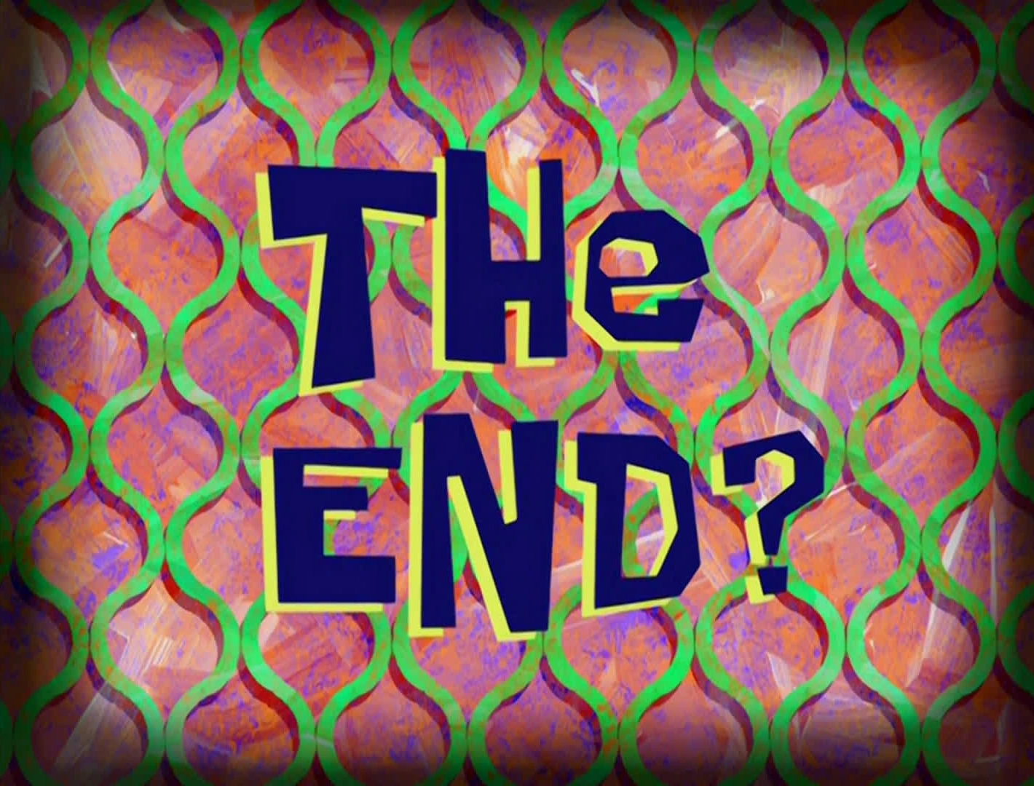
THE END?

